Slide 1
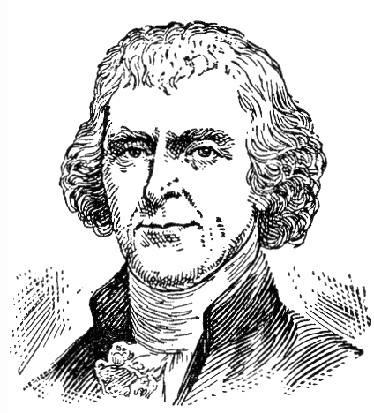
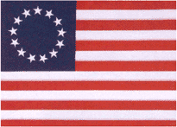
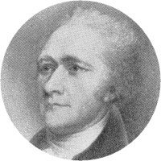
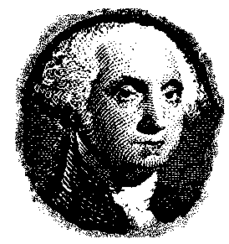
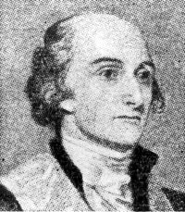
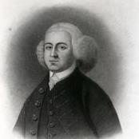
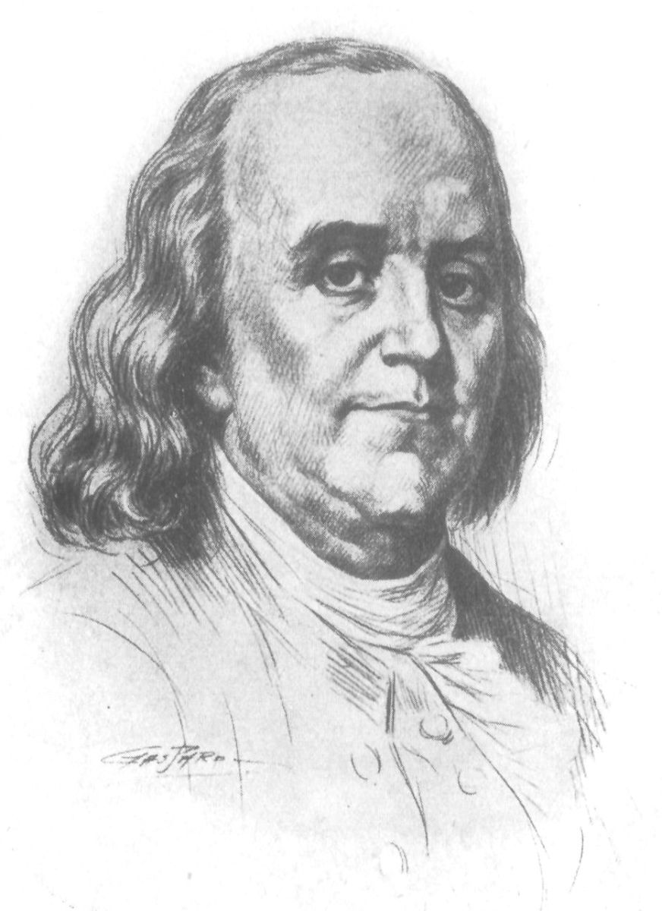
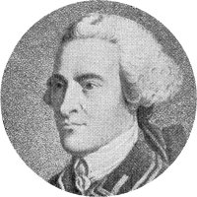
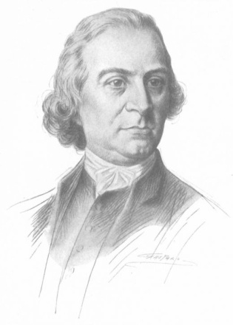
THE GRAVE TOUR, R.I.P. THE FOUNDING FATHER’S OF THE UNITED STATES OF AMERICA
Notes:
HELLO MY NAME IS ________________. THANK YOU FOR INVITING ME TO MAKE THIS PRESENTATION. I HOPE THAT YOU FIND THIS PROGRAM INTERESTING, AND AGAIN MANY THANKS FOR YOUR CORDIAL INVITATION. THIS IS A GREAT COUNTRY, AND PART OF THE GREATESTNESS THAT THE UNITED STATES HAS ENJOYED FOR OVER 200 YEARS IS THE BASIC FOUNDATIONS OF PHILOSOPHY OF GOVERNMENT WHICH THE PEOPLE THAT TODAY WE CALLED AFFECTIONATELY OUR “FOUNDING FATHERS” SET UP IN THE BEGINNING. THE TERM “FOUNDING FATHERS” WAS FIRST USED BY PRESIDENT WARREN G. HARDING IN THE 1920’S IN A SPEECH HE DELIVERED AT ARLINGTON NATIONAL CEMETERY. THE TERM BECAME POPULAR AND TODAY IT IS USED CONSTANTLY IN ALL TYPES OF COMMUNICATIONS. WHEN AMERICAN’S HEAR THE TERM “FOUNDING FATHERS” WE ALMOST ALL KNOW PRECISELY WHAT IS BEING REFERRED TO. BUT WHO WERE THE ACKNOWLEDGED “FOUNDING FATHERS? AND FOR OUR PURPOSES IN THIS PROGRAM, MYSELF BEING A FUNERAL PROFESSION, WE ARE GOING TO ANSWER THE QUESTIONS CONCERNING THE DEATHS AND BURIALS OF THIS ELITE GROUP OF EARLY AMERICANS – OUR BELOVED “FOUNDING FATHERS.” SO ONCE AGAIN THANK YOU AND I HOPE THAT YOU ENJOY THIS PROGRAM.

Slide 2
Notes:
THIS IS TRUMBULL’S FAMOUS CANVAS DEPICTING THE SIGNING OF THE DECLARATION OF INDEPENDENCE. NOT ALL THE OF THE TRADITIONAL ACCEPTED LIST OF “FOUNDING FATHERS” ARE SHOWN HERE. FOR INSTANCE GEORGE WASHINGTON WAS ON THE BATTLEFIELD WHEN THIS SIGNING HAPPENED. HOWEVER I HAVE HIGHLIGHTED WITH BLUE ARROWS AND NUMBERS THE FOUNDING FATHERS THAT ARE INCLUDED IN THIS PROGRAM. NUMBER ONE WITH THE TWO BLUE ARROWS IS JOHN HANCOCK. NUMBER TWO IS BENJAMIN FRANKLIN. NUMBER THREE IS THOMAS JEFFERSON. NUMBER FOUR IS JOHN ADAMS. AND NUMBER FIVE IS SAMUEL ADAMS SITTING IN THE BACK OF THE ROOM. THE STORY GOES THAT COUSINS JOHN AND SAMUEL ADAMS COULD NOT ABIDE EACH OTHER SO THE MORE POWERFUL OF THE TWO RELATIVES, WHICH OF COURSE WAS JOHN, PUSHED HIS BREWER COUSIN SAMUEL TO THE BACK OF THE ROOM. POLITICS IWASPOLITICS EVEN IN 1776.

Slide 3
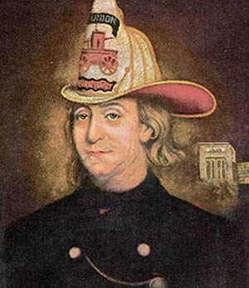
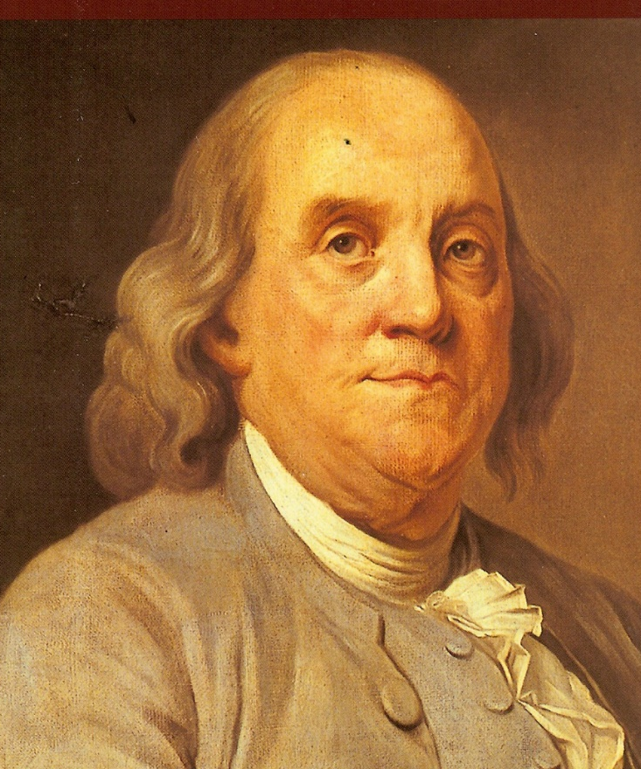
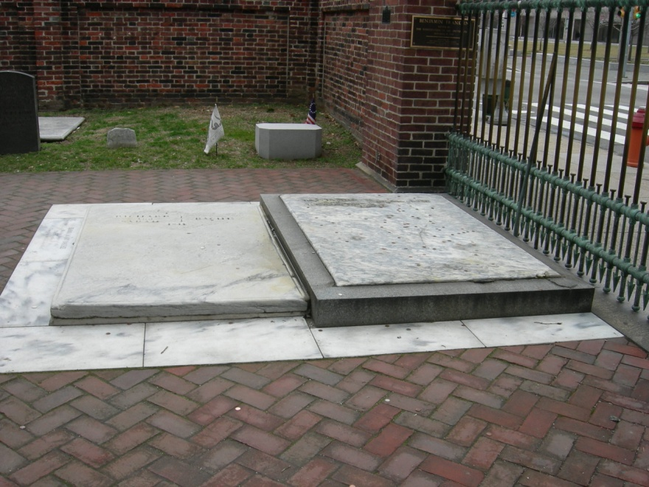
BENJAMIN FRANKLIN 1706 (O.S. 1705) – 1790 CHRIST CHURCHYARD CEMETERY, PHILADELPHIA
Notes:
THE FIRST FOUNDING FATHER IS PROBABLY ONE OF THE MOST BELOVED OF THE FOUNDING FATHERS – GOOD OLD BENJAMIN FRANKLIN. FRANKLIN WAS AMERICA’S FIRST RENAISSANCE MAN, HE WAS A PRINTER FROM BOSTON WHO EXPERIMENTED WITH ELECTRICITY, STARTED THE FIRST VOLUNTEER FIRE DEPARTMENT IN THE COUNTRY, AND IN SIGNING THE DECLARATION OF INDEPENDENCE BECAME ONE OF THE FIRST COLONIAL DIPLOMATS WHO HELPED TO NEGOTIATE THE 1783 TREATY OF PARIS WHICH ENDED THE AMERICAN REVOLUTION AND HENCE RECOGNIZED AMERICAN INDEPENDENCE. HE ALSO DEVELOPED THE POSTAL SERVICE AND SERVED AS AMERICAN’S FIRST POSTMASTER GENERAL. IF IT HAD NOT BEEN FOR HIS ADANCED AGE HE COULD EASILY HAVE BECOME OUR FIRST PRESIDENT. HE AND HIS WIFE DEBORAH ARE BUIRED IN CHRIST CHURCH BURIAL GROUND IN DOWNTOWN PHILADELPHIA, JUST INSIDE THE IRON GATE THAT YOU CAN SEE IN THIS IMAGE. ON THE GRAVE SLAB IS INSCRIBED ONLY THEIR NAMES, BUT THE EPITAPH FRANKLIN COMPOSED FOR HIMSELF MANY DECADES BEFORE IS AFFIXED AT EYE LEVEL BESIDE THE GRAVE. IT READS: THE BODY OF B. FRANKLIN, PRINTER, LIKE THE COVER OF AN OLD BOOK, ITS CONTECTS TORN OUT AND STRIPPED OF ITS LETTERING AND GILDING, LIES HERE, FOOD FOR WORMS. BUT THE WORK SHALL NOT BE LOST, FOR IT WILL AS HE BELIEVED APPEAR ONCE MORE IN A NEW AND ELEGANT ADDITION, CORRECTED AND IMPROVED BY THE AUTHOR.” THE COINS WHICH ARE TOSSED ON FRANKLIN’S GRAVE ARE THOUGHT TO HAVE ORIGINATED AS A GOOD LUCK SYMBOL BECAUSE THE PHILADELPHIA MINT WAS LOCATED ACROSS THE STREET FROM THE CEMETERY.

Slide 4
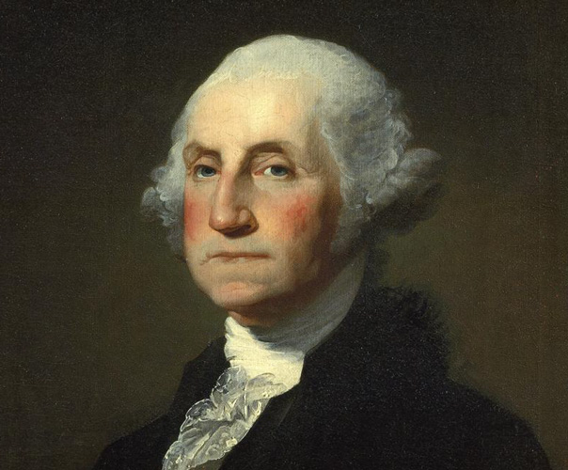
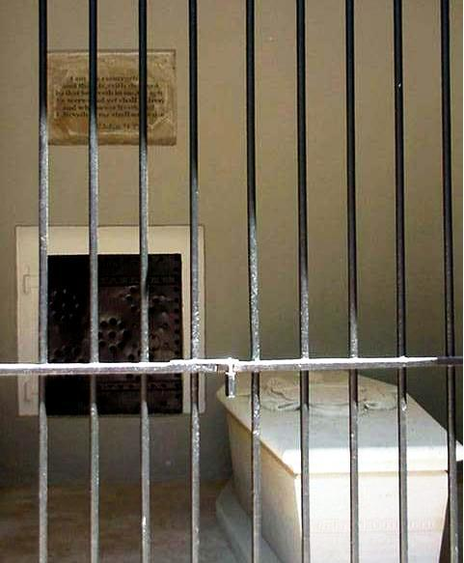
GEORGE WASHINGTON 1732 – 1799 THE NEW TOMB, MOUNT VERNON
Notes:
WASHINGTON IS POPULARLY KNOWN AS THE FATHER OF HIS COUNTRY. HE WAS THE COMMANDING GENERAL OF THE COLONIAL ARMY IN THE REVOLUTION AND THE FIRST PRESIDENT OF THE UNITED STATES. WASHINGTON RETIRED TO HIS ESTATE MOUNT VERNON WHERE HE REGULARLY RODE HIS HORSE AROUND INSPECTING HIS ESTATE; ON DECEMBER 12, 1799 HE DID SO IN SLEET AND SNOW FOR FIVE HOURS. THE COLD THIS PRODUCED QUICKLY TURNED TO WHAT WAS TERMED ACUTE INFLAMMATORY EDEMA. A TRACHEOTOMY, IN 1799 NEW AND DANGEROUS, MIGHT HAVE RELIEVED THE PROBLEM BUT WAS NOT TRIED – TOO RISKY. IN DYING WASHINGTON ASKED THAT HIS BODY NOT BE PUT INTO THE TOMB UNTIL THREE DAYS AFTER DEATH – HE FEARED BEING BURIED ALIVE, THEN HE THANKED THE DOCTORS, SAYING THAT HE WAS GOING AND THERE WAS NOTING MORE THEY COULD DO. WASHINGTON’S BODY WAS ORIGINALLY NOT PLACED IN THE TOMB YOU ARE LOOKING AT, IT WAS PLACED IN AN ANCIENT TOMB WHICH WAS HALFWAY DOWN THE SLOPE OF THE HILL FROM MOUNT VERNON. THOUGH THIS ORIGINAL TOMB STILL STAND HIS COFFIN WAS REMOVED WHEN THIS PRESENT TOMB WAS CONSTRUCTED FARTHER DOWN TOWARD THE POTOMAC AND PLACED THERE ALONG WITH MANY OTHER FAMILY MEMBERS.

Slide 5
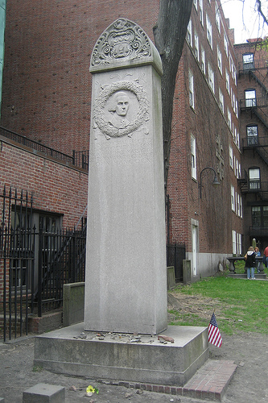
JOHN HANCOCK 1737 (O.S. 1736) – 1793 GRANARY BURIAL GROUNDS, BOSTON
Notes:
MOST FAMOUS BECAUSE A WORLD FAMOUS INSURANCE COMPANY WAS NAMED AFTER HIM, THE REAL JOHN HANCOCK SERVED AS CHAIRMAN OF THE CONTINENTAL CONGRESS IN PHILADELPHIA AND WAS THE FIRST TO MARCH UP TO SIGN THE DECLARATION OF INDEPENDENCE. HIS FAMOUS SIGNATURE, MUCH LARGER THAN THE OTHERS, WAS GIVEN HE SUPPOSEDLY SAID, SO KING GEORGE COULD READ IT WITHOUT WEARING HIS SPECTACLES. THIS SIGNATURE IS SO FAMOUS THAT IT HAS GIVEN RISE TO ANY SIGNATURE BEING REFERRED TO AS SOMEONES “JOHN HANCOCK.” AFTER THE REVOLUTION HE SERVED AS THE FIRST GOVERNOR OF MASSACHUSETTS. JOHN HANCOCK WAS ONE OF THE FIRST MILLIONAIRES IN THE COLONIES. THIS WHITE SHAFT MARKING HIS GRAVE IN THE GRANARY BURIAL GROUNDS IN DOWNTOWN BOSTON WAS DEDICATED ON 1896.

Slide 6
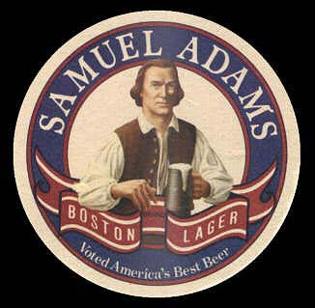
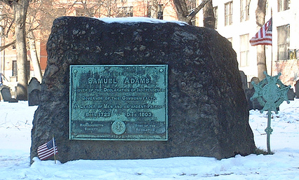
SAMUEL ADAMS 1722 – 1803 GRANARY BURIAL GROUNDS, BOSTON
Notes:
SAMUEL ADAMS TODAY IS KNOWN AS HAVING A FAMOUS BEER NAMED IN HIS HONOR. TRUTH IS SAMUEL ADAMS WAS A BOSTON BREWER, BUT HE WAS ALSO AN INFAMOUS COLONIAL RABBLE ROUSER AND COUSIN TO THE MORE FAMOUS AND HIGHLY CANTAKEROUS JOHN ADAMS. IT IS BELIEVED THAT SAMUEL ADAMS WAS ONE OF THE MAJOR INSTIGATORS OF PLANNING THE FAMOUS “BOSTON TEA PARTY.” HIS GRAVE IS MARKED IN THE GRANARY BURIAL GROUNDS IN BOSTON WITH THIS MASSIVE BOULDER, ONLY A STONES THROUGH AWAY FROM THE GRAVE OF JOHN HANCOCK.

Slide 7
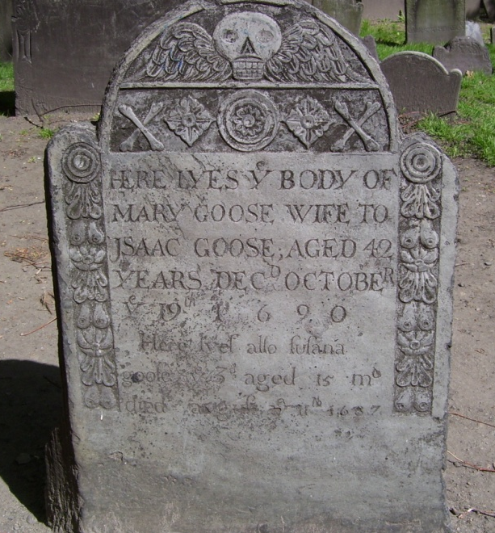
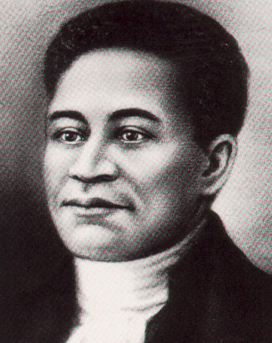
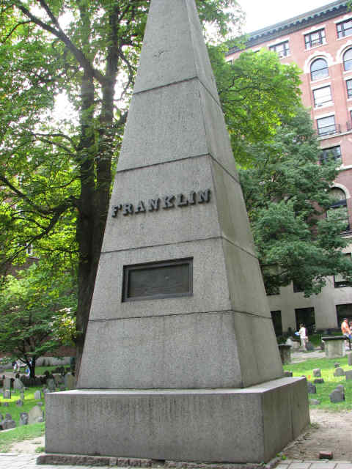
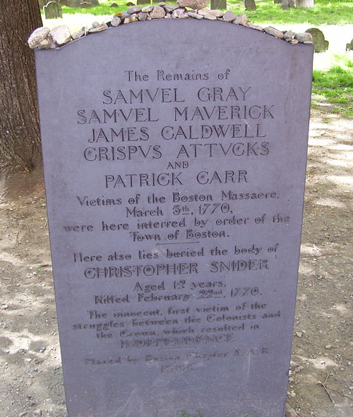
ALSO BURIED IN BOSTON’S GRANARY BURIAL GROUNDS IS ACROSS THE TOP ROW PAUL REVERE, MOTHER GOOSE, AND CRISPIN ATTUCKS (FIRST CAUSUALTY OF THE AMERICAN REVOLUTION – KILLED IN THE BOSTON MASSACRE THE BOTTOM ROW ARE BENJAMIN FRANKLIN’S PARENTS AND THE VICTIMS OF THE BOSTON MASSACRE
Notes:
THE GRANARY BURIAL GROUNDS IN DOWNTOWN BOSTON DESERVES A FEW COMMENTS ON ITS OWN. WITHIN THE GROUNDS OF THIS ANCIENT COLONIAL BURIAL GROUND GOING CLOCKWISE FROM RIGHT TO LEFT STARTING AT THE TOP LEFT, IS THE WHITE GRAVESTONE MARKING THE FINAL RESTING PLACE OF PAUL REVERE, NEXT IN THE MIDDLE IS THE TYPICAL COLONIAL GRAVESTONE OF NONE OTHER THAN MARY GOOSE BETTER KNOWN AS “MOTHER GOOSE.” THE DRAWING OF THE MAN AND THE MONUMENT BELOW IS THAT OF CRISPUS ATTUCKS THE FIRST FATALITY FROM THE “BOSTON MASSACRE” WHICH WAS A GROUP OF COLONIAL PROTESTORS WHO WERE KILLED BY BRITISH SOLDIERS ON A SNOWY EVENING NEXT TO THE OLD STATE HOUSE IN BOSTON. CRISPUS ATTUCKS, WAS A YOUNG AFRICAN-AMERICAN MAN WHO IS CONSIDERED TO BE THE FIRST CAUSUALTY OF THE AMERICAN REVOLUTION. FINALLY THE LARGE OBELISK AT BOTTOM LEFT IS THE BURIAL PLACE FOR THE PARENTS OF BENJAMIN FRANKLIN. PROBABLY NO OTHER CEMETERY EXCEPT ARLINGTON NATIONAL CEMETERY HAS MORE CONNECTION TO AMERICAN HISTORY.

Slide 8
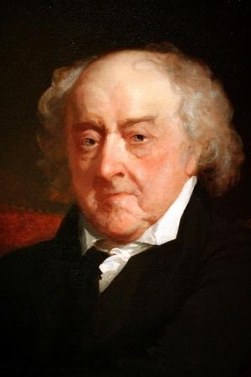
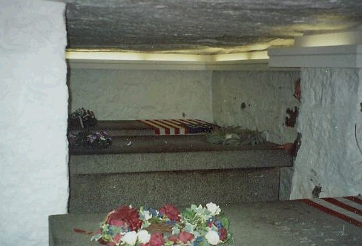
JOHN ADAMS 1735 – 1826 THE ADAMS FAMILY CRYPT – FIRST PARISH (UNITARIAN), QUINCY, MASSACHUSETTS
Notes:
GEORGE WASHINGTON MIGHT HAVE BEEN THE MILITARY LEADERSHIP OF THE AMERICAN REVOLUTION, AND THOMAS JEFFERSON MIGHT HAVE BEEN THE LITERARY TALENT OF THE AMERICAN REVOLUTION, BUT IS WAS IRASIBLE OLD JOHN ADAMS WHO HAD THE STUBBORN LOCKJAW ATTITUDE AND LEGAL BRAINS TO KEEP THE REVOLUTION MOVING FORWARD. IN ONE OF THE MOST HAUNTING COINCIDENCES IN AMERICAN HISTORY IS THAT THE ONLY TWO MEN WHO SIGNED THE DECLARATION OF INDEPENDENCE, AND LATER BOTH BECAME PRESIDENTS OF THE UNITED STATES NAMELY JOHN ADAMS AND THOMAS JEFFERSON DIED ON THE 50TH ANNIVERSARY ON SIGNING THE DECLARATION, ON JULY 4, 1826 WITHIN HOURS OF EACH OTHER. IT IS THOUGHT THAT ADAMS SPOKE HIS LAST WORDS ABOUT HIS FELLOW SIGNER JEFFERSON STILL SURVIVING. ADAMS HAD NO WAY TO KNOW THAT JEFFERSON HIMSELF HAD DIED ABOUT FIVE HOURS EARILER. ADAMS WAS ORIGINALLY ENTOMBED IN THE HANCOCK CEMETERY IN QUINCY BUT WAS LATER MOVED TO A NEW CRYPT CHAMBER BELOW THE FIRST UNITARIAN CHURCH WHERE THEY REMAIN IN CONCRETE TOMBS ALONG WITH THOSE OF HIS SON JOHN QUINCY AND HIS WIFE LOUISA. THE CRYPT CHAMBER BELOW THE CHURCH IN QUINCY IS REMARKABLE IN THAT IT IS THE ONLY PLACE WHERE TWO PRESIDENTS AND TWO FIRST LADIES ARE INTERRED.

Slide 9
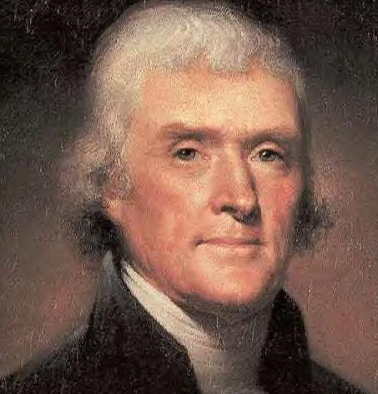
THOMAS JEFFERSON 1743 – 1826 JEFFERSON FAMILY CEMETERY, MONTICELLO
Notes:
A TRUE RENESSAINCE MAN THOMAS JEFFERSON WAS A STATESMAN, AUTHOR OF THE DECLARATION OF INDEPENDENCE, A INTERNATIONAL DIPOLMATE, A AGRICULTURAL EXPERIMENTER (HE INTRODUCED TOMATOES TO THE AMERICAN TABLE) A NATURALIST AND PROLIFIC INVENTOR. JEFFERSON DIED AT AGE 83, DEEPLY IN DEBT ON JULY 4, 1826 ON THE SAME DAY AS JOHN ADAMS AND ON THE 50TH ANNIVERSARY OF BOTH MEN SIGNING THE DECLARATION OF INDEPENDENCE. JEFFERSON DESIGNED HIS OWN MONUMENT AND PENNED THIS INSCRIPTION: HERE WAS BURIED THOMAS JEFFERSON, AUTHOR OF THE DECLARATION OF INDEPENDENCE, OF THE STATUTE OF VIRGINIA FOR RELIGIOUS FREEDOM, AND FATHER OF THE UNIVERSITY OF VIRGINIA. INTERESTINGLY JEFFERSON OMITTED THE FACT THAT HE HAD SERVED AS PRESIDENT OF THE UNITED STATE FOR EIGHT YEARS.

Slide 10
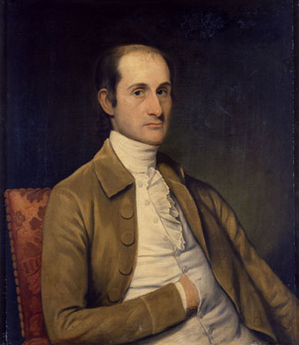
JOHN JAY 1745 – 1829 JOHN JAY CEMETERY, RYE, NEW YORK
Notes:
JOHN JAY WHO YOU MIGHT BE ASKING? WELL JOHN JAY DESERVES OUR ATTENTION IN THIS PROGRAM. JAY WAS A COLONIAL STATESMAN FROM NEW YORK AND HELPED AUTHOR THE FEDERALIST PAPERS WITH JAMES MADISON AND ALEXANDER HAMILTON, WHICH WAS A KEY INSTRUMENT IN PUSHING FOR THE RATIFICATION OF THE UNITED STATES CONSITUTION. JAY ALSO SERVED AS THE FIRST CHIEF JUSTICE OF THE UNITED STATE SUPREME COURT AND BASICALLY ORGANIZED THE ENTIRE FEDERAL JUDICIAL SYSTEM. HE LATER SERVED AS GOVERNOR OF NEW YORK STATE. HE RETIRED TO HIS FARM IN UPSTATE NEW YORK, AND DIED THERE AT THE AGE OF 83.

Slide 11
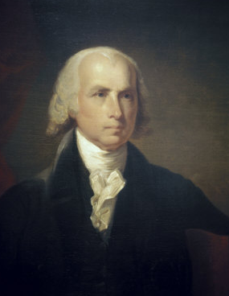
JAMES MADISON 1751 – 1836 MADISON FAMILY BURYING GROUNDS, MONTPIELER, VIRGINIA
Notes:
JAMES MADISON WAS THE FOURTH PRESIDENT OF THE UNITED STATES, AND WAS PRESIDENT DURING THE WAR OF 1812 WHEN THE BRITISH BURNED THE WHITE HOUSE. HOWEVER MOST NOTABLE WAS NOT THAT HE WAS PRESIDENT, BUT THAT HE CO-AUTHORED THE FEDERALIST PAPERS, AND BASICALLY WROTE THE ENTIRE UNITED STATES CONSTITUTION BY HIMSELF. MADISON WAS A LEGAL AND POLITICAL WIZARD, AND HIS OTHER NOTEWORTHY ACCOMPLISHMENT IS THAT TO THIS DAY HE HOLDS THE RECORDS FOR BEING THE SMALLEST PRESIDENT IN HISTORY. MADISON STOOD 5 FEET TALL AND WEIGHT IN AT 100 LBS. MADISON SURIVED MOST OF THE OTHER FOUNDING FATHERS, AND SLIPPED QUIETLY FROM LIFE AT HIS ESTATE AT AGE 85. WHEN HIS NIECE ASKED HIM WHAT WAS WRONG HE REPLIED “NOTHING MORE THAN A CHANGE OF MIND, MY DEAR.” HE WAS BURIED IN THIS FAMILY GRAVEYARD ON HIS ESTATE. THE GRAVEYARD IS ACCESSIBLE ONLY BY A DIRT ROAD, AND IS VERY ISOLATED. LITTLE HAS CHANGED IN THIS GRAVEYARD SINCE MADISONS DEATH IN 1836.

Slide 12
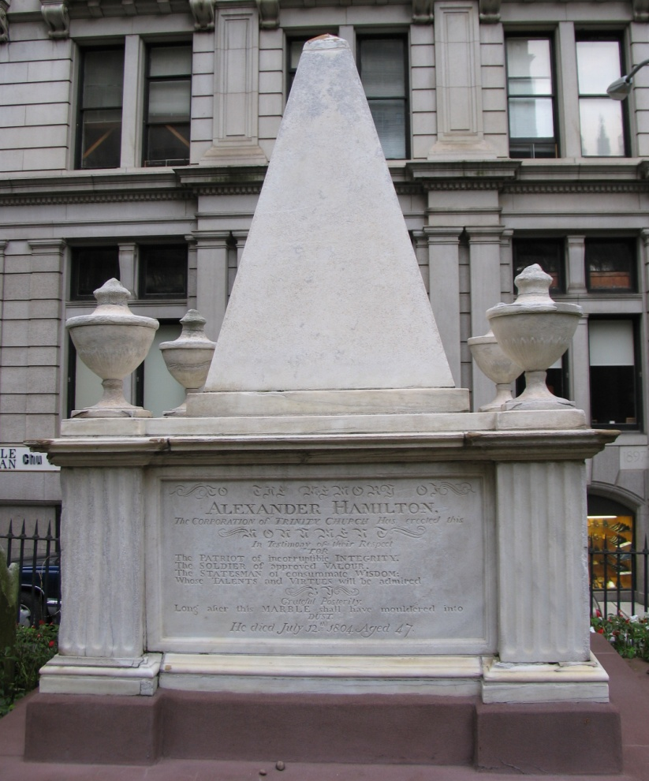
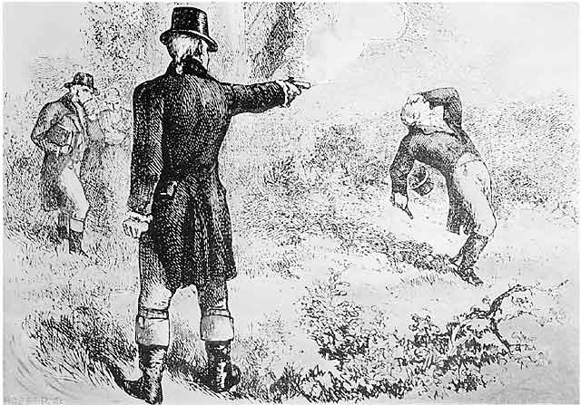
ALEXANDER HAMILTON 1755 – 1804 TRINITY CHURCHYARD, MANHATTAN
Notes:
HAMILTON IS MORE THAN THE PERSON ON THE TEN DOLLAR BILL. HE WAS BORN IN THE WEST INDIES, AND CO-AUTHORED THE FEDERALIST PAPERS, AND SERVED AS WASHINGTON’S SECRETARY OF TREASURY AT WHICH HE WAS DESCRIBED AS BEING A FINANCIAL GENIUS. HAMILTON WAS ALSO INVOLVED IN THE FIRST AMERICAN POLITICAL SEX SCANDAL, WHICH HE SURVIVED, HOWEVER HAMILTON WAS WRECKLESS IN MORE MATTERS THAT JUST HIS ROMANTIC INVOLVEMENTS. HAMILTON WAS CALLED OUT BY VICE-PRESIDENT AARON BURR TO A PISTOL A DUEL FOR MAKING SLURS AGAINST BURR’S CHARACTER. ALTHOUGH HAMILTON WAS AGAINST DUELING (HIS SON HAD DIED IN A DUEL IN 1803) HE WAS CHALLENEGED BY THEN VICE PRESIDENT AARON BURR OVER ALLEGED SLURS – BURR WAS VERY TOUCHY CONCERNING HIS HONOR. IN A DRAMATIC SCENE AT A GATHERING THE NIGHT BEFORE THE DULE WHERE BOTH MEN WERE PRESENT, HAMILTON GOT UP ON A TABLE AND SANG A MOURNFUL SCOTCH BALLAD “THE DRUM.” BURR WAS NOT IMPRESSED. THE TWO MEN MET AT DAWN THE NEXT MORNING ACROSS THE HUDSON AT WEEHAWKEN, NEW JERSEY, WHERE HAMILTON BEGGED PARDON FOR HAVING TO PUT HIS SPECTABLES ON. ALTHOUGH HE APPEARED TO INTENTIONALLY MISS BURR, BURR’S SUBSEQUENT SHOT FATALLY WOUNDED HAMILTON. HE WAS TAKEN BY BOAT BACK TO MANHATTAN WHERE HE DIED AT AGE 49 AFTER CONSIDERABLE AGONY. THIS MONUMENT YOU SEE HERE IS ALONG THE SOUTHERN EDGE OF TRINITY CHURCHARD IN LOWER MANHATTAN AND IS TOPPED WITH AN IMPRESSIVE PYRAMID. THERE IS ALSO A MONUMENT WITH A BUST OF HAMILTON ON A PEDESTAL OF STONES ON THE HEIGHTS AT WEEHAWKEN, ABOVE THE SITE OF THE FAMOUS DUEL.

Slide 13
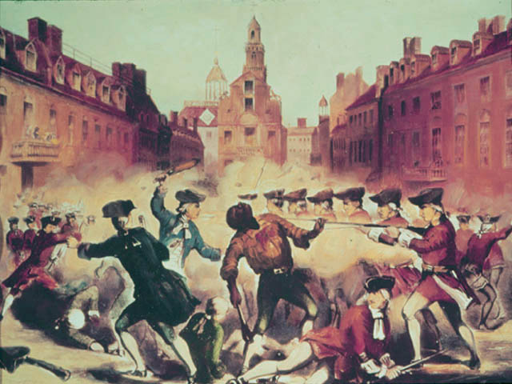
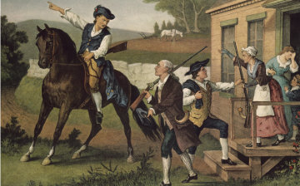
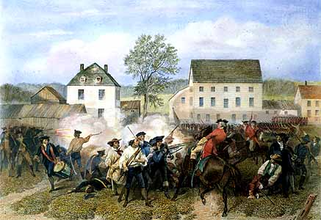
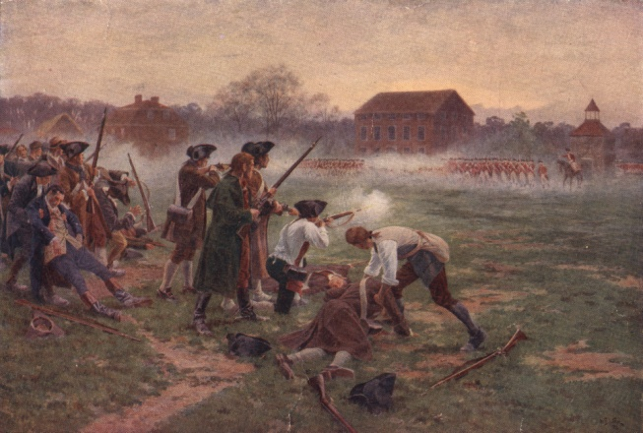
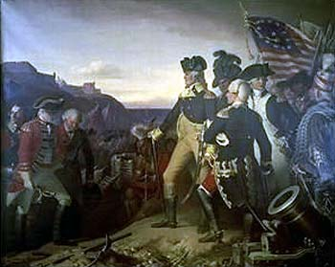
Notes:
SO THAT IS THE STORY OF WHO OUR FOUNDING FATHERS WERE, AND WHERE THEY FOUND THEIR FINAL RESTING PLACES. EACH GRAVE REPRESENTS A STORY OF ONE HUMAN’S BEINGS SACRIFICE WITH THE NEW IDEA THAT PEOPLE COULD LIVE FREE. THE CORRECTNESS OF THAT NEW IDEA ABOUT FREEDOM HAS CERTAINLY BEEN CHALLENGED, SOMETIMES BEEN CLOSE TO LOST, THEN FOUND AGAIN, BUT IT HAS ALWAYS BEEN FOUGHT FOR. THE FOUNDING FATHERS SENT ONE PREMIER LESSON CONCERNING HUMAN FREEDOM, FREEDOM IS NOT FREE. IT IS SPECULATED BY SOME CYNICS THAT OUR FOUNDING FATHERS WOULD NOT REMOTELY RECOGNIZE THE UNITED STATES SHOULD THEY RETURN. HOWEVER THESE MEN WERE MEN OF VISION AND COURAGE, AND THEY SOUGHT CHANGE, SO OTHERS MORE OPTIMISTIC PEOPLE FEEL THAT IF THEY SHOULD RETURN THEY WOULD NOT BE SURPRISED IN THE LEAST TO SEE WHAT SUBSEQUENT GENERATIONS OF AMERICAN’S HAVE DONE WITH THE IDEA OF HUMAN FREEDOM. FROM THE BOSTON MASSACRE, TO PAUL REVERE’S RIDE, TO THE BATTLES ON LEXINGTON AND CONCORD GREEN, TO THE SURRENDER OF THE BRITISH AT YORKTOWNE, THE SPIRIT OF 1776 HAS CREATED ONE OF THE MOST UNIQUE AND FASCINATING EXPERIENCES KNOWN TO THE ANNUALS OF RECORDED HISTORY NAMELY – THE UNITED STATES OF AMERICA. THIS CONCLUDES MY PROGRAM, I DO HOPE YOU HAVE ENJOYED MY PRESENTATION AND THANK YOU AGAIN FOR INVITING ME.

